Slide 1

Café Harmony Dashboard Analysis
Data-Driven Insights & Strategic Recommendations
March 2025
Done by: Mary Olowo
Notes:
Welcome, everyone 😘.Today, we’ll analyze Café Harmony's performance across multiple locations. This data-driven analysis will focus on key insights and strategic recommendations to enhance business performance. Let’s get started.

Slide 2
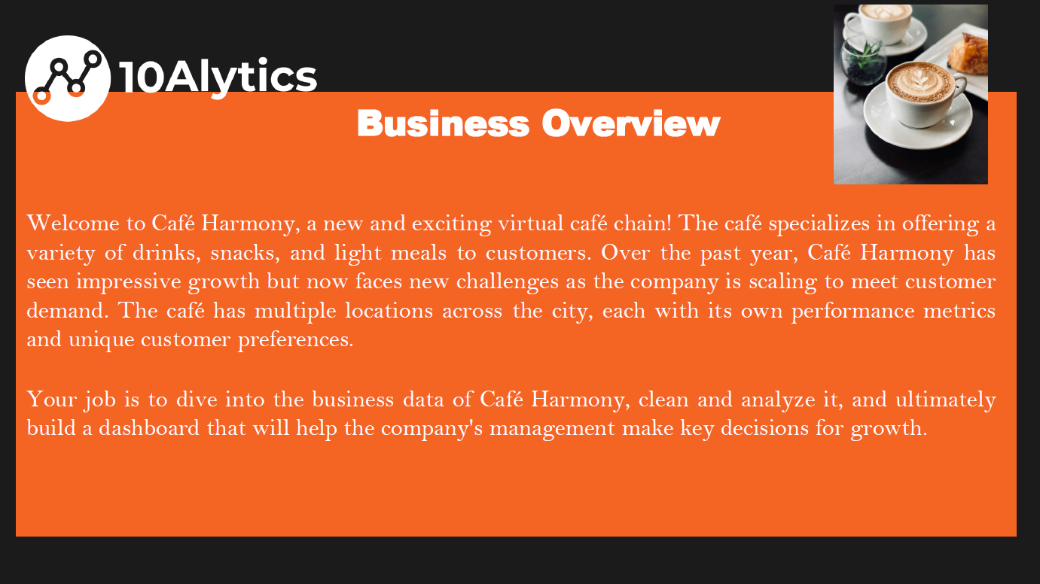
Notes:
Café Harmony operates in a competitive market where customer satisfaction and operational efficiency are key to success. This analysis focuses on critical business areas: sales data, customer demographics, inventory management, employee performance, and customer feedback. The goal is to identify strengths, uncover weaknesses, and propose actionable strategies to optimize performance.

Slide 3
Introduction & Objectives
1. Executive Summary
2. Menu Performance Analysis
3. Customer Demographics
4. Inventory Management
5. Employee Performance
6. Customer Satisfaction
7. Strategic Recommendations
8. Implementation Timeline
9. Q&A
CAFÉ HARMONY
Notes:
Café Harmony operates in a competitive market where customer satisfaction and operational efficiency are key to success. This analysis focuses on critical business areas: sales data, customer demographics, inventory management, employee performance, and customer feedback. The goal is to identify strengths, uncover weaknesses, and propose actionable strategies to optimize performance.

Slide 4
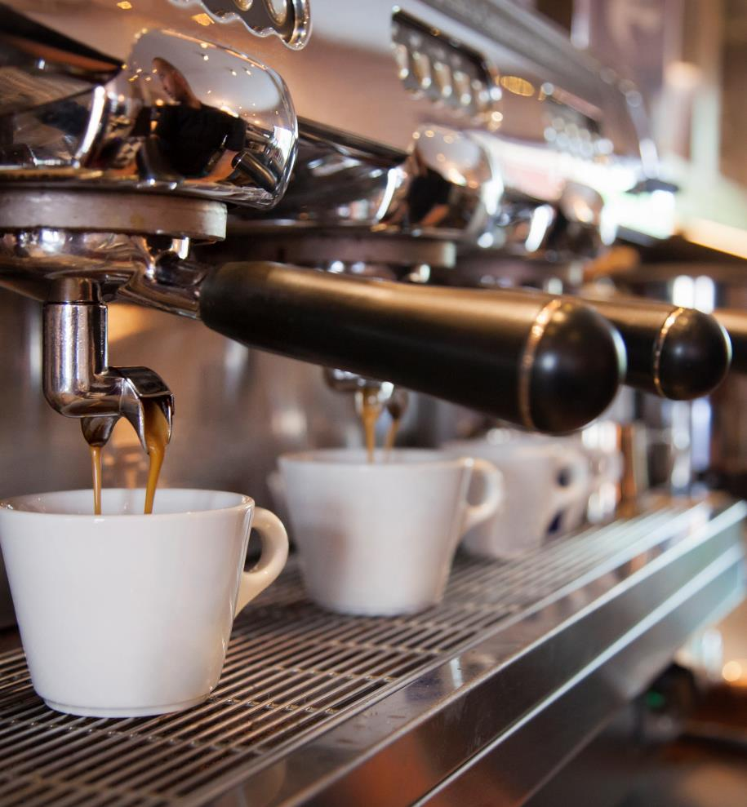
Introduction & Objectives
Business Context: Café Harmony multi-location performance analysis
Analysis Scope: Sales data, customer demographics, inventory, employee performance, and customer feedback
Presentation Goals:
- Presents key performance insights
- Identifies operational improvement opportunities
- Recommends strategic actions

Slide 5
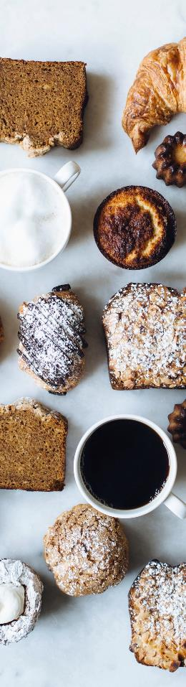


Executive Summary
The Overall Performance Status
✅ Strong product performance with steady sales growth
⚠ Operational challenges impacting efficiency and service
Critical Areas for Attention
🔹 Inventory Management: Significant understocking leading to service disruptions
🔹 Customer Satisfaction: Ratings indicate need for experience improvements
🔹 Employee Performance: Variability in sales performance requires standardization
Strategic Opportunity
💡 Leverage top-performing products and customer demographic insights to drive targeted marketing, optimize operations, and boost overall business performance.
Strong product sales drive performance, but operational challenges need urgent attention. Key concerns include inventory issues, inconsistent customer satisfaction, and employee performance gaps. However, leveraging top-selling products and demographic trends presents a growth opportunity. This presentation highlights key insights and solutions.
Notes:
Strong product sales drive performance, but operational challenges need urgent attention. Key concerns include inventory issues, inconsistent customer satisfaction, and employee performance gaps. However, leveraging top-selling products and demographic trends presents a growth opportunity. This presentation highlights key insights and solutions.

Slide 6
Top Revenue-Generating Products(Menu Performance)
My Note: Regarding menu performance, muffins lead in revenue generation, followed by cappuccinos and iced tea. This in regards presents an opportunity to create bundle deals and promotions around top-performing items. Diversification remains important, but marketing should emphasize best-sellers to drive profitability.
Notes:
Regarding menu performance, muffins lead in revenue generation, followed by cappuccinos and iced tea. This presents an opportunity to create bundle deals and promotions around top-performing items. Diversification remains important, but marketing should emphasize best-sellers to drive profitability.

Slide 7




💡 Key Findings:
Muffins generate the highest revenue ($2,401.07)
Cappuccino and Iced Tea are strong sellers
Opportunity to bundle high-performing products
📊 Trends & Business Recommendations:
✔ Introduce Muffin + Cappuccino combo deals
✔ Adjust pricing and promotions based on sales performance (e.g. a few discounts can be given on the high-volume selling Muffin products)
✔ Maintain menu diversity while prioritizing best-sellers

Slide 8
Customer Demographics Deep Dive
My Note: Our customer data shows that 54.19% of our customers are female, while 45.81% are male, highlighting an opportunity for gender-specific marketing strategies. The gender split varies significantly across age groups, with 18-30 being our only male-majority segment, while women aged 31-56 form our core demographic strength. This presents a strategic advantage in reinforcing female engagement while also developing initiatives to retain and grow our male customer base. Loyalty programs, personalized promotions, and targeted advertising can help engage both demographics more effectively, ensuring sustained growth and balanced customer retention.
Notes:
Our customer data shows that 54.19% of our customers are female, while 45.81% are male, highlighting an opportunity for gender-specific marketing strategies. The gender split varies significantly across age groups, with 18-30 being our only male-majority segment, while women aged 31-56 form our core demographic strength. This presents a strategic advantage in reinforcing female engagement while also developing initiatives to retain and grow our male customer base. Loyalty programs, personalized promotions, and targeted advertising can help engage both demographics more effectively, ensuring sustained growth and balanced customer retention.

Slide 9
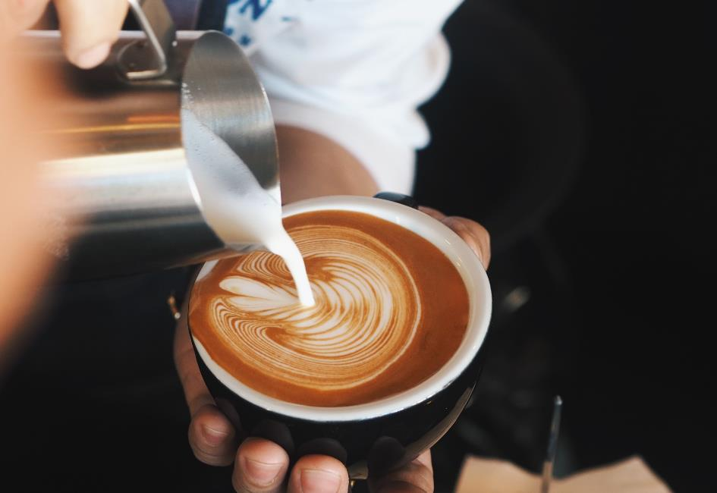

🔍 Key Findings:
✔ Female customers lead at 54.19%, while males make up 45.81%
✔ Gender distribution shifts by age—males dominate only in the 18-30 bracket
✔ Core purchasing power lies in female customers aged 31-56
📈 Trends & Market Potential:
✔ Strong engagement from females in prime spending years (31-56)
✔ Growth opportunity in retaining younger male customers (18-30)
✔ Widening gender gap in older demographics suggests potential market shifts
🎯 Strategic Recommendations:
✔ Targeted marketing—age and gender-specific campaigns to enhance engagement
✔ Loyalty programs—tailored incentives to boost retention in key segments
✔ Customer lifecycle strategies—initiatives to maintain younger male engagement over time
✔ Brand advocacy—leverage strong female presence for ambassador programs

Slide 10
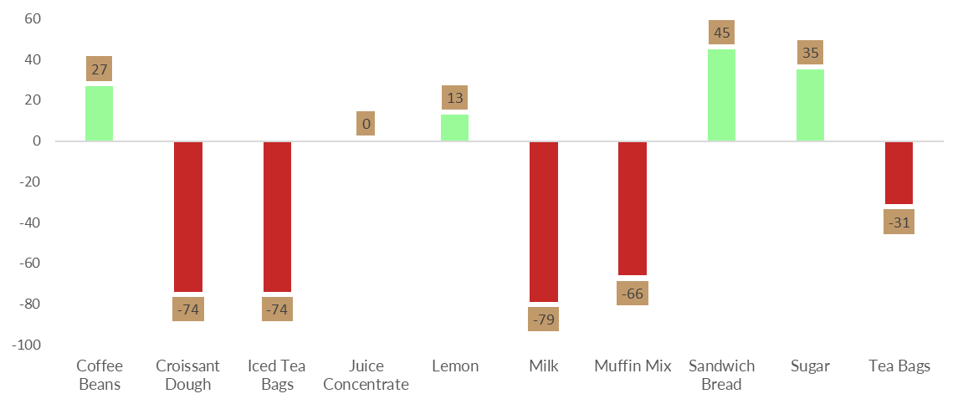
Critical Stock Status
My Note: Inventory shortages are a critical issue affecting customer service and sales. Key items like milk, croissant dough, and iced tea bags are significantly understocked, leading to potential menu limitations. The root cause appears to be manual tracking and inconsistent ordering. An automated inventory management system can help prevent stockouts and improve efficiency.
Notes:
Inventory shortages are a critical issue affecting customer service and sales. Key items like milk, croissant dough, and iced tea bags are significantly understocked, leading to potential menu limitations. The root cause appears to be manual tracking and inconsistent ordering. An automated inventory management system can help prevent stockouts and improve efficiency.

Slide 11
💡Critical Alert:
✔ Severe understocking of essential items:
Milk (-79 units)
Croissant Dough (-74 units)
Iced Tea Bags (-74 units)
Muffin Mix (-66 units)
📊 Business Impact:
✔ Risk of service disruptions and lost sales due to stockouts
✔ Customer dissatisfaction from unavailable products
✔ Highest performing product (Muffins) risks being out of stock
🔍 Root Causes:
✔ Manual inventory tracking leading to errors
✔ Inconsistent ordering practices causing supply gaps
🚀 Action Plan:
✔ Implement an automated inventory management system
✔ Establish minimum stock thresholds for high-demand items
✔ Assign inventory accountability to staff for better tracking

Slide 12
Employee Performance Comparison
My Note: Employee performance varies significantly, with top performers like Megan White and Elizabeth Johnson generating the highest sales. Understanding what makes them successful can help standardize high performance across all locations. Training programs, incentives, and performance monitoring will help bridge the gap between employees.
Notes:
Employee performance varies significantly, with top performers like Megan White and Elizabeth Johnson generating the highest sales. Understanding what makes them successful can help standardize high performance across all locations. Training programs, incentives, and performance monitoring will help bridge the gap between employees.

Slide 13
💡 Key Insights:
✔ Top Performers:
Megan White: 11,095 sales
Elizabeth Johnson: 10,702 sales
✔ Performance Variability: Notable differences in sales across employees
✔ Opportunity: Standardize and improve overall team performance
🚀 Action Plan:
✔ Identify & analyze successful strategies used by top performers
✔ Develop a structured training program to uplift low performers
✔ Implement performance incentives to encourage consistent high sales

Slide 14
Customer Satisfaction Analysis
Menu Performance Overview: Muffins lead in revenue at $2,401.07, followed by Cappuccino and Iced Tea. Products like Cappuccino and Croissant show negative-to-positive feedback imbalances, signaling room for improvement.
Key Opportunities: Focus on improving Cappuccino and Croissant based on negative feedback. Leverage the strong performance of Muffins and Iced Tea to boost overall sales.
Strategic Actions: Introduce combo deals (e.g., Muffin + Cappuccino), enhance underperforming products, and apply successful insights from Muffins and Iced Tea to improve customer satisfaction and drive sales.
Notes:
Menu Performance Overview: Muffins lead in revenue at $2,401.07, followed by Cappuccino and Iced Tea. Products like Cappuccino and Croissant show negative-to-positive feedback imbalances, signaling room for improvement.
Key Opportunities: Focus on improving Cappuccino and Croissant based on negative feedback. Leverage the strong performance of Muffins and Iced Tea to boost overall sales.
Strategic Actions: Introduce combo deals (e.g., Muffin + Cappuccino), enhance underperforming products, and apply successful insights from Muffins and Iced Tea to improve customer satisfaction and drive sales.

Slide 15
💡Critical Alert:
✔ Overall Feedback Distribution:
34% negative
34% Neutral
32% positive
✔ Highest Negative Sentiment:
Latte has the highest negative feedback with 71 negative ratings
✔ Strongest Positive Feedback:
Latte also garners the highest positive feedback at 76 ratings
✔ "Could Be Better" vs "Great Product":
Categories labeled "Could be better" consistently receive 2-3x more feedback than those labeled "Great product." This suggests ample opportunities for product improvements.
📊 Performance Analysis:
✔ Problematic Products: Cappuccino and Croissant show concerning negative-to-positive ratios: Cappuccino: 67 negative vs. 54 positive Croissant: 69 negative vs. 62 Positive.
✔ Best-Selling Products: Muffin generates the highest sales at $2,401.07, followed by Cappuccino ($2,315.06) and Iced Tea ($2,234.56). These are our top performers in terms of revenue.
✔ Latte: Latte shows a high level of polarization, with both the most positive and negative feedback. This suggests room for improvement while maintaining its popularity, generating $1,957.22 in sales.
✔ Balanced Feedback Products: Iced Tea and Muffin have a more balanced customer response and stronger sales relative to other items. Muffin: $2,401.07Iced Tea: $ 2,234.56. These products present a good foundation for leveraging customer satisfaction.
🚀 Strategic Recommendations:
✔ Improve Cappuccino and Croissant: Address negative feedback in these top-sellers to boost satisfaction.
✔ Analyze Latte Polarization: Investigate what drives both positive and negative feedback to refine the product.
✔ Create Response Protocols: Implement quick and effective responses for negative feedback, especially for high-volume items.
✔ Leverage Iced Tea and Muffin Insights: Use successful features from these products to improve others.
✔ Bundle High-Performing Items: Introduce combo deals like Muffin + Cappuccino to drive sales and customer satisfaction.

Slide 16
Cross-Correlation Analysis & Strategic Recommendations
Cross-Correlation Analysis
Strategic Recommendations
💡 Key Insights:
✔ Preferred Product, Service Quality & Customer Ratings: Top-performing products and employee services lead to higher customer satisfaction
✔ Inventory Issues & Product Performance: Stockouts directly impact the sales of even highest highest-performing products (e.g., Muffins)
✔ Product Preferences by Demographic: Target both genders with personalized offers
✔ Highest performing products which Is our cash cow (Muffins) sells the most (5 quantities) in Uptown: Attention should be paid to the service quality delivery at the Uptown location
🔍 Business Intelligence:
✔ Operational challenges are interconnected and impact overall performance.
✔ Addressing inventory issues can improve customer satisfaction and sales.
✔ Improving customer experience in Uptown locations to maintain high sales values is imperative
💡 Menu Optimization Strategy:
✔ Create Muffin + Cappuccino combo deals
✔ Adjust pricing strategy based on performance data
✔ Develop a seasonal promotional calendar
💡 Inventory Management Overhaul:
✔ Implement an automated inventory system
✔ Establish emergency stock thresholds for critical items
✔ Create staffing accountability for inventory checks
💡 Employee Excellence Program:✔ Standardize training based on top performer behaviors✔ Implement recognition and incentive structures
✔ Set consistent performance expectations
💡 Customer Experience Transformation:✔ Launch structured feedback collection system✔ Create response protocol for negative reviews✔ Set customer satisfaction KPI targets by location
Notes:
Insights:
High-performing employees boost customer satisfaction.
Inventory shortages hurt sales and ratings.
Demographics show product preferences.
Recommendations:
Menu: Bundle deals, adjust pricing, plan promotions.
Inventory: Automate tracking, set restocking levels, assign accountability.
Employees: Standardize top behaviors, provide training & incentives.
Customer Experience: Improve feedback, respond to reviews, set KPIs.

Slide 17
Timeline
Insights
Implementation Timeline
📅 Q2 2025 Priorities:
✔ Implement automated inventory system
✔ Launch staff training program
✔ Roll out menu optimization initiatives
📅 Q3 2025 Initiatives:
✔ Develop customer feedback program
✔ Implement loyalty program
✔ Start performance monitoring system
📅 Q4 2025 Planning:
✔ Review initiative effectiveness and assess results
✔ Adjust strategies based on outcomes
✔ Plan for 2026 objectives
High-performing employees boost customer satisfaction.
Inventory shortages hurt sales and ratings.
Demographics show product preferences.
Recommendations:
Menu: Bundle deals, adjust pricing, plan promotions.
Inventory: Automate tracking, set restocking levels, and assign accountability.
Employees: Standardize top behaviors and provide training & incentives.
Customer Experience: Improve feedback, respond to reviews, and set KPIs.
Notes:
Execution will take place over three quarters in 2025.
Q2: Focus on operational efficiency, including inventory automation and employee training.
Q3: Implement customer engagement strategies, including feedback programs and loyalty initiatives.
Q4: Evaluate results, refine strategies, and prepare for 2026 expansion.

Slide 18
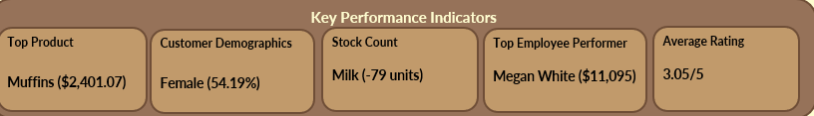
Expected Outcomes & KPI Targets
Inventory Efficiency:
✔ Target: Reduce stockouts by 95%
📊 Customer Satisfaction:
✔ Target: Increase average customer rating to 4.0/5
📊 Employee Performance:
✔ Target: Reduce performance variability by 25%
📊 Revenue Growth:
✔ Target: Increase average transaction value by 15%
📊 Profitability:
✔ Target: Improve operating margin by 10%
Notes:
Our strategic initiatives aim to achieve measurable improvements: Reduce stockouts by 95%.
Increase customer satisfaction scores to 4.0/5.
Standardize employee performance, reducing variability by 25%.
Boost revenue by 15% through better product positioning.
Improve operating margin by 10%.
These targets will ensure long-term sustainability and profitability.

Slide 19


Q&A and Discussion
💬 Discussion Points:
✔ Review of key findings
✔ Discussion on implementation priorities
✔ Clarification on next steps and accountabilities
Notes:
That concludes the presentation. I’d love to hear your thoughts, questions, and insights. Let’s discuss key takeaways and any concerns about implementation.

Slide 20

Thank You
Mary Olowolajuogbon

